Slide 1
Hashed Alpha Testing
Chris Wyman
Morgan McGuire
Traditional
Hashed
Symposium on Interactive 3D Graphics and Games; February 25, 2017

Slide 2
STory
Never, in my life, expected to write a paper about alpha testing

Slide 3
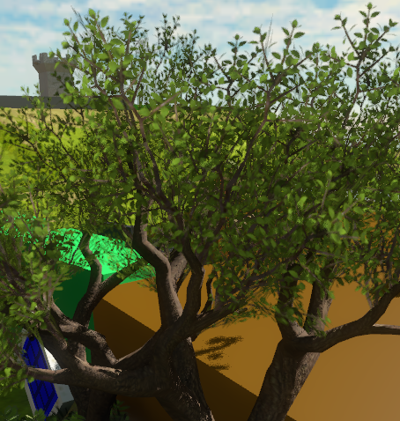
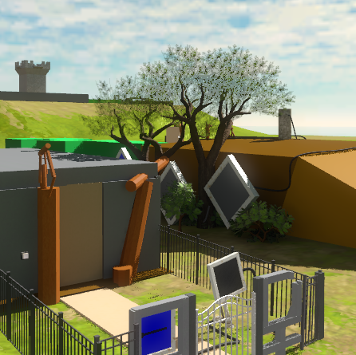
STory
Never, in my life, expected to write a paper about alpha testing
15 months ago, I didn’t even know a problem existed with alpha test
Was sent a link to blog post on Computing Alpha Mipmaps
Thought: “Really!? Alpha maps disappear with distance? Weird.”
Forgot about the issue

Slide 4
STory
Never, in my life, expected to write a paper about alpha testing
15 months ago, I didn’t even know a problem existed with alpha test
Was sent a link to blog post on Computing Alpha Mipmaps
Thought: “Really!? Alpha maps disappear with distance? Weird.”
Forgot about the issue
Recently: Talking about a different problem
Had a bit of a miscommunication, ended up discussing this problem
As part of the discussion, Morgan asked, “why don’t people just hash?”

Slide 5
Moral:
Game developers: Share your problems; don’t assume we know them!
Informal poll of a couple (former) academics: 0% knew about this problem

Slide 6
Moral:
Game developers: Share your problems; don’t assume we know them!
Informal poll of a couple (former) academics: 0% knew about this problem
Researchers: Don’t assume simple problems are solved

Slide 7
Moral:
Game developers: Share your problems; don’t assume we know them!
Informal poll of a couple (former) academics: 0% knew about this problem
Researchers: Don’t assume simple problems are solved
Students: Search for problems where you can have an impact
Research need not be hard
Hare-brained idea to accepted research paper: 12 weeks

Slide 8
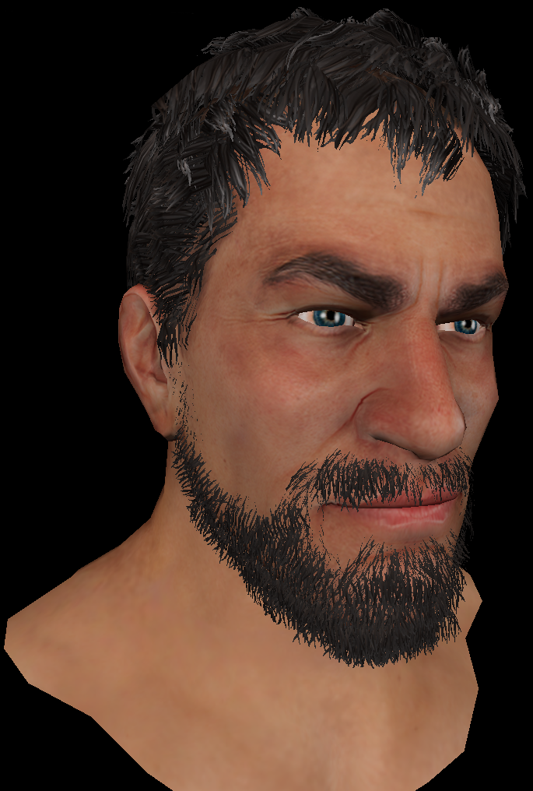
Why Do People Alpha Test?
Has advantages over alpha blend
Order independent; cheap; forward or deferred
Extends to MSAA via alpha-to-coverage

Slide 9
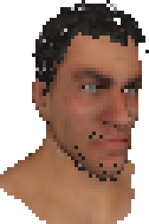
But… Problem
Has advantages over alpha blend
Order independent; cheap; forward or deferred
Extends to MSAA via alpha-to-coverage
Alpha-tested geom can disappear w / distance

Slide 10
But… Problem
Has advantages over alpha blend
Order independent; cheap; forward or deferred
Extends to MSAA via alpha-to-coverage
Alpha-tested geom can disappear w / distance
Why? Cannot prefilter binary visibility queries

Slide 11
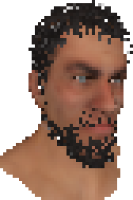
So: Hashed Alpha Test
Use stochastic sampling to avoid the problem

Slide 12
So: Hashed Alpha Test
Use stochastic sampling to avoid the problem
Basic idea is replace standard test:
With stochastic test:

Slide 13
So: Hashed Alpha Test
Use stochastic sampling to avoid the problem
Basic idea is replace standard test:
With stochastic test:
But, this flickers like crazy
Want temporal stability, esp. under slight motion
Use stable, procedural noise:

Slide 14
What Does this Look Like?
Alpha Test
Hashed Alpha
Ground Truth

Slide 15
Talk Takeaways
Stochasm addresses problems with alpha testing
Converges to ground truth (OIT) with enough random samples

Slide 16
Talk Takeaways
Stochasm addresses problems with alpha testing
Converges to ground truth (OIT) with enough random samples
Hashing can give noise stable over time

Slide 17
Talk Takeaways
Stochasm addresses problems with alpha testing
Converges to ground truth (OIT) with enough random samples
Hashing can give noise stable over time
By constraining hash inputs:
Control noise behavior
Ensure samples remain largely stable between frames

Slide 18
Talk Takeaways
Stochasm addresses problems with alpha testing
Converges to ground truth (OIT) with enough random samples
Hashing can give noise stable over time
By constraining hash inputs:
Control noise behavior
Ensure samples remain largely stable between frames
Also applies to alpha-to-coverage, screen-door transparency, etc.

Slide 19
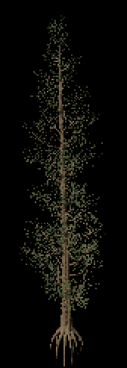
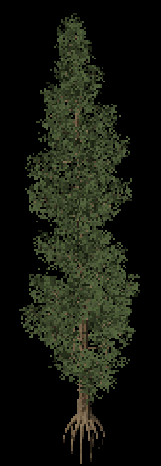
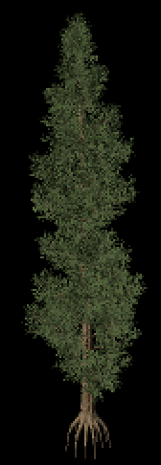
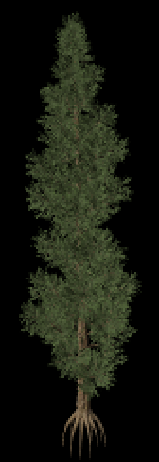
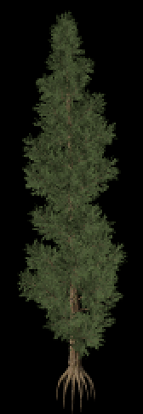
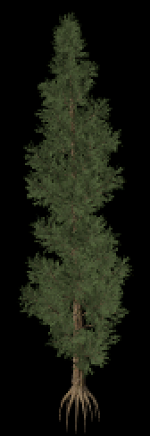
Stochastic Sampling Works
Alpha test
1 sample
4 samples
16 samples
64 samples
OIT with
alpha blend

Slide 20
Stochastic Sampling Works
Traditional Alpha
Alpha-to-Coverage
Stochastic Alpha (aka stochastic transparency)
1/2
1/8
1 sample, selected uniformly
on interval [0..1]
3/8
5/8
7/8
N samples, selected uniformly
on interval [0..1]
N samples, selected randomly
on interval [0..1]
Alpha test
1 sample
4 samples
16 samples
64 samples
OIT with
alpha blend

Slide 21
Stochastic Sampling Works
Traditional Alpha
Alpha-to-Coverage
Stochastic Alpha (aka stochastic transparency)
1/2
1/8
1 sample, selected uniformly
on interval [0..1]
3/8
5/8
7/8
N samples, selected uniformly
on interval [0..1]
N samples, selected randomly
on interval [0..1]
But stochastic algorithms change each frame, causing severe temporal flickering!
Alpha test
1 sample
4 samples
16 samples
64 samples
OIT with
alpha blend

Slide 22
Why Hashing?
Hashing long known as a way of ‘randomizing’
See “Numerical Recipes” for an example PRNG using DES encryption

Slide 23
Why Hashing?
Hashing long known as a way of ‘randomizing’
See “Numerical Recipes” for an example PRNG using DES encryption
Good hash function properties:
Determinism given fixed input i.e., gives the same value each frame
Defined range of outputs e.g., in range [0…1)
Uniformity over output range e.g., uniform outputs in range [0…1)

Slide 24
Why Hashing?
Hashing long known as a way of ‘randomizing’
See “Numerical Recipes” for an example PRNG using DES encryption
Good hash function properties:
Determinism given fixed input i.e., gives the same value each frame
Defined range of outputs e.g., in range [0…1)
Uniformity over output range e.g., uniform outputs in range [0…1)
Can select hash so these have equivalent quality, modulo stability:
if ( color.a < hash( fragPos ) ) discard; if ( color.a < drand48() ) discard;

Slide 25
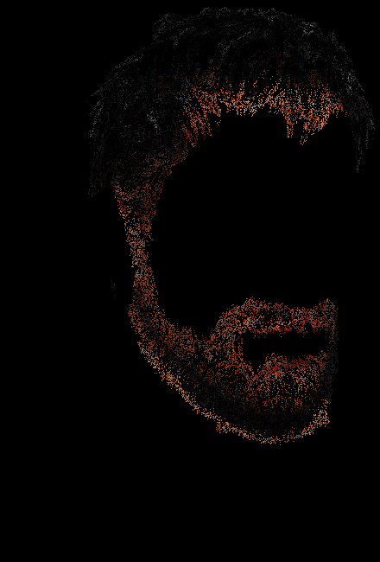
What Do I Mean BY “Stability”?
Frame-to-frame diff
Frame-to-frame diff
Unstable
Stable
Diff image under motion,
uncorrelated samples

Slide 26
Achieving Hash Stability
Key: Discretize hash inputs in appropriate coordinate frame
For small Δ:
hash( floor( myPosition ) ) = hash( floor( myPosition + Δ ) )
Tweaking this, allows us to control the scale of the stable noise, e.g.:
hash( floor( myPosition / scale ) * scale )

Slide 27
Achieving Hash Stability
Key: Discretize hash inputs in appropriate coordinate frame
For small Δ:
hash( floor( myPosition ) ) = hash( floor( myPosition + Δ ) )
Tweaking this, allows us to control the scale of the stable noise, e.g.:
hash( floor( myPosition / scale ) * scale )
Ideally, same geometry should yield same hash under:
Camera translation or rotation
Object translation or rotation
Ideally, object skinning and deformation

Slide 28
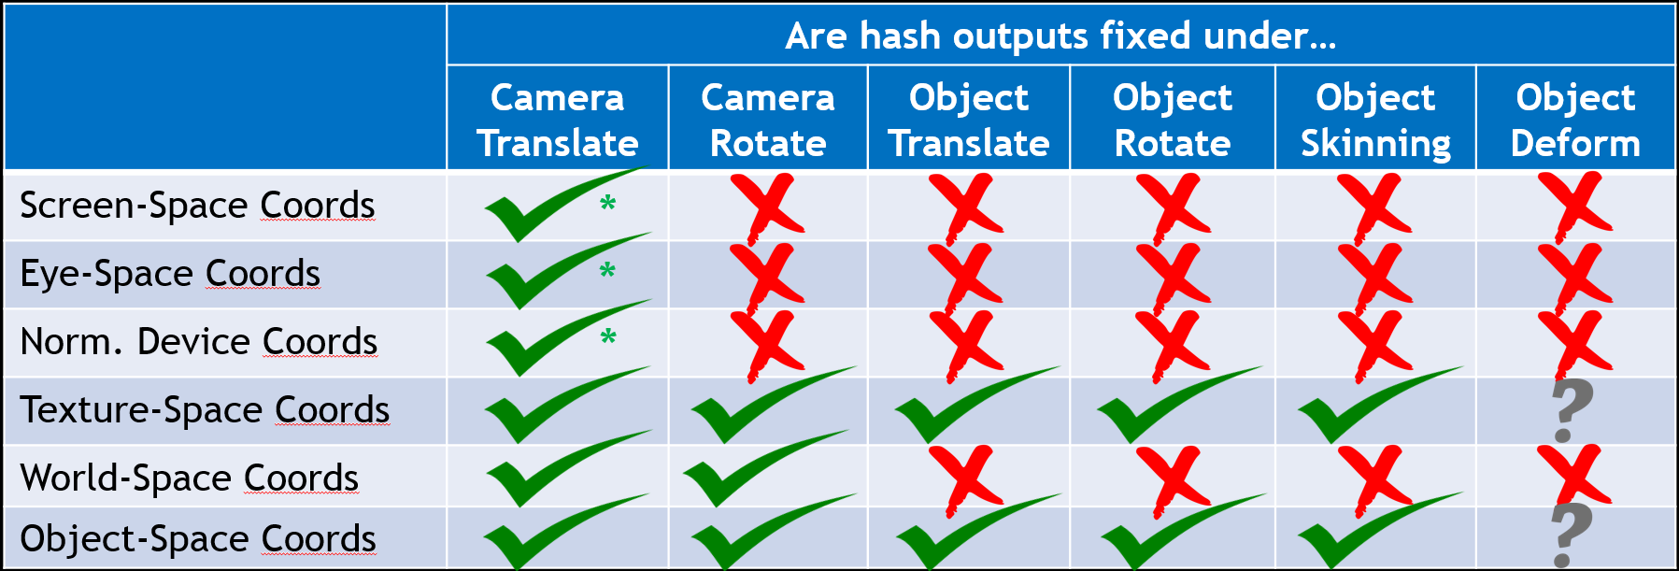
Choice of Coordinate Frame
.’s work for deformation (and skinning) assuming hashing of pre-deformed coordinates
* = being somewhat generous

Slide 29
Choice of Coordinate Frame
Clear choices:
.’s work for deformation (and skinning) assuming hashing of pre-deformed coordinates
* = being somewhat generous

Slide 30
Choice of Coordinate Frame
We selected object coordinates; can discuss why, offline
.’s work for deformation (and skinning) assuming hashing of pre-deformed coordinates
* = being somewhat generous

Slide 31
Hashed Alpha Code

Slide 32
Hashed Alpha Code
Compute ideal scale to get 1-pixel sized noise

Slide 33
Hashed Alpha Code
Compute ideal scale to get 1-pixel sized noise
Use 2 scales, one smaller & one larger than
desired scale; akin to mipmapping

Slide 34
Hashed Alpha Code
Compute ideal scale to get 1-pixel sized noise
Use 2 scales, one smaller & one larger than
desired scale; akin to mipmapping
Compute hashed noise samples at 2 discrete scales

Slide 35
Hashed Alpha Code
Compute ideal scale to get 1-pixel sized noise
Use 2 scales, one smaller & one larger than
desired scale; akin to mipmapping
Compute hashed noise samples at 2 discrete scales
Linearly interpolate between noise scales

Slide 36
Hashed Alpha Code
Compute ideal scale to get 1-pixel sized noise
Use 2 scales, one smaller & one larger than
desired scale; akin to mipmapping
Compute hashed noise samples at 2 discrete scales
Linearly interpolate between noise scales
Interpolating between two uniform distributions
does not give a new uniform distribution
This math corrects for this non-uniformity

Slide 37
Hashed Alpha Code
Compute ideal scale to get 1-pixel sized noise
Use 2 scales, one smaller & one larger than
desired scale; akin to mipmapping
Compute hashed noise samples at 2 discrete scales
Linearly interpolate between noise scales
Interpolating between two uniform distributions
does not give a new uniform distribution
This math corrects for this non-uniformity
Clamp; alpha threshold of 0 makes no sense

Slide 38
Hashed Alpha Code
Specific hash not important, if uniform and
takes R³ → [0…1)
We use:

Slide 39
Hashed Alpha Code
User parameter to control size of noise:
1.0 = roughly pixel sized noise
2.0 = roughly 2x2 pixel sized noise
3.0 = roughly 3x3 pixel sized noise

Slide 40
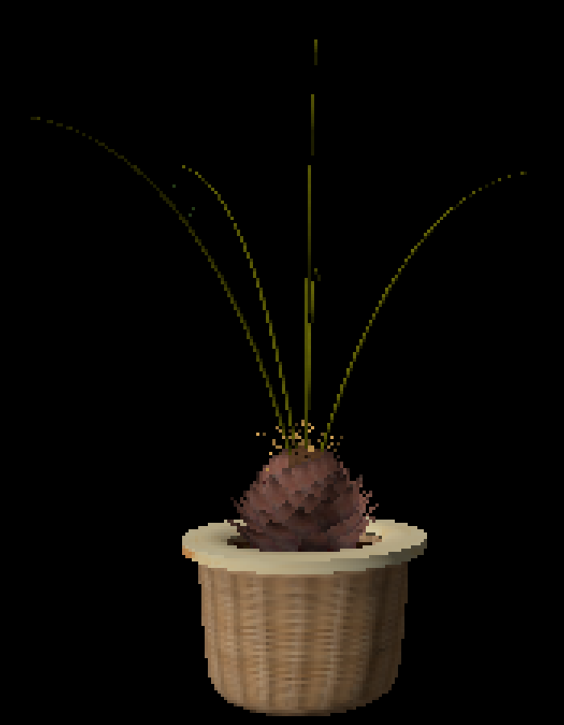
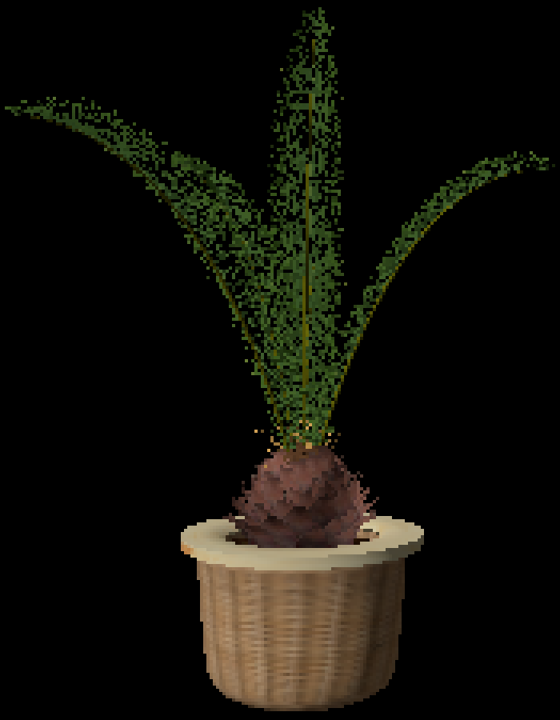
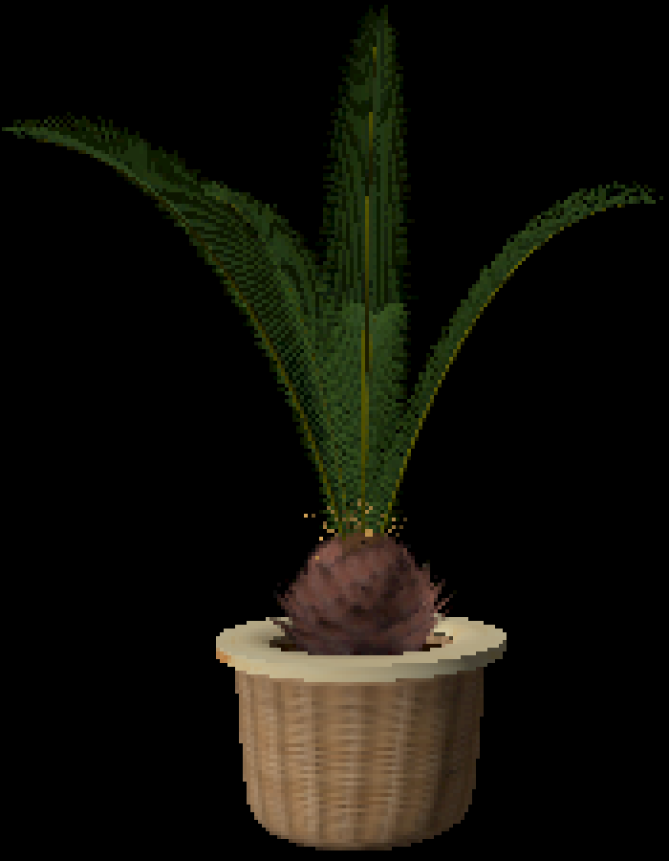
Some Results
Alpha test α_{t} = 0.5
Hashed alpha test
Ground truth OIT
0.06 ms @ 1024²
0.08 ms @ 1024²
1.3 ms @ 1024²
Performances not optimized; only demonstrative of relative costs

Slide 41
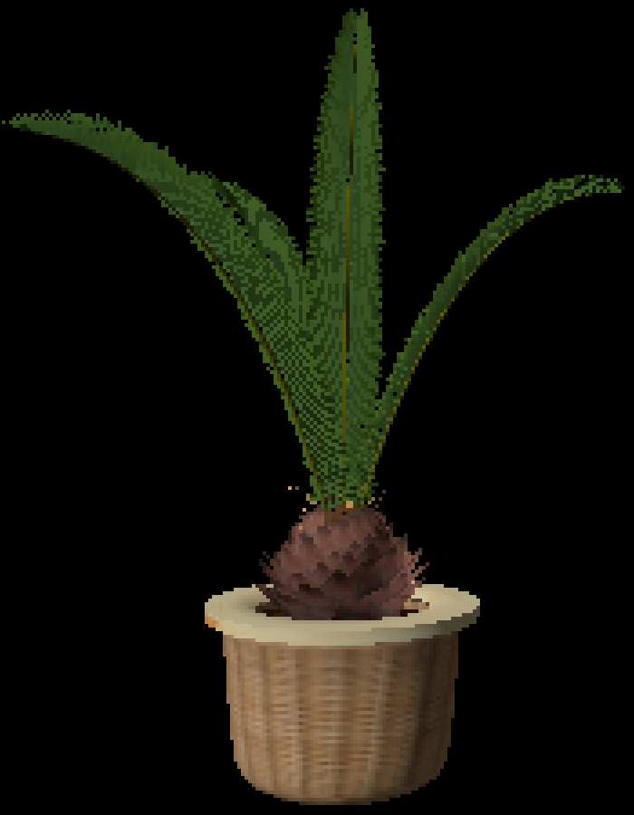
Some Results
Adjust alpha [Castaño 2010]
Hashed alpha test
Ground truth OIT
0.06 ms @ 1024²
0.08 ms @ 1024²
1.3 ms @ 1024²
Performances not optimized; only demonstrative of relative costs

Slide 42
But Not Just Alpha!

Slide 43
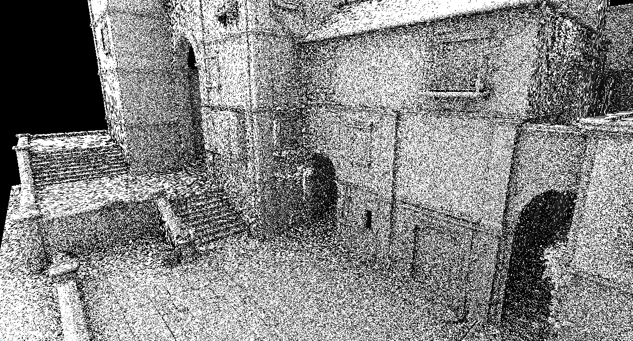
HASHED Sampling HAS OTHER USES
NEW! Not discussed in I3D paper: stable hashed sampling in other domains

Slide 44
HASHED Sampling HAS OTHER USES
Shows there’s a problem with anisotropic hashing!
NEW! Not discussed in I3D paper: stable hashed sampling in other domains

Slide 45
HASHED Sampling HAS OTHER USES
Can be addressed, mostly, by updating hash inputs
NEW! Not discussed in I3D paper: stable hashed sampling in other domains

Slide 46
Hashing At Grazing Angles
Alpha test
Hashed alpha
Anisotropic
hashed alpha

Slide 47
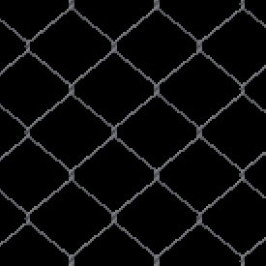
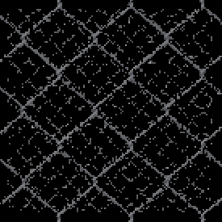
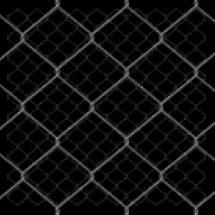
Results
Alpha test α_{t} = 0.5
Hashed alpha test
Ground truth OIT

Slide 48
Results
Alpha test α_{t} = 0.5
Hashed alpha test
Ground truth OIT
Might ask:
Do I want noise nearby?
(Alpha test is OK here)

Slide 49
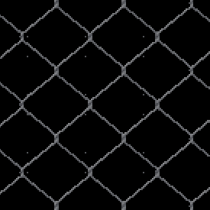
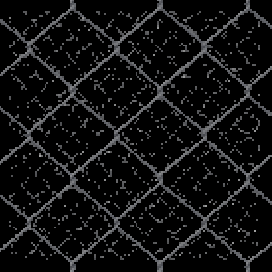
Results
Adjust alpha [Castaño 2010]
Hashed alpha test
(Faded in with LOD)
Ground truth OIT

Slide 50
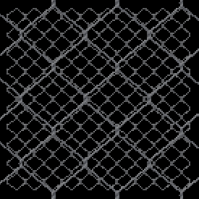
Results
Per-LOD threshold adjust
(Manual, “artist” driven)
Hashed alpha test
(Faded in with LOD)
Ground truth OIT

Slide 51
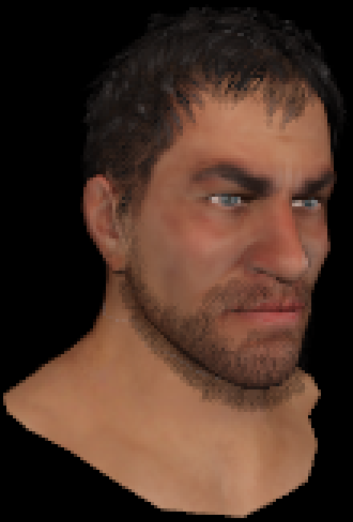
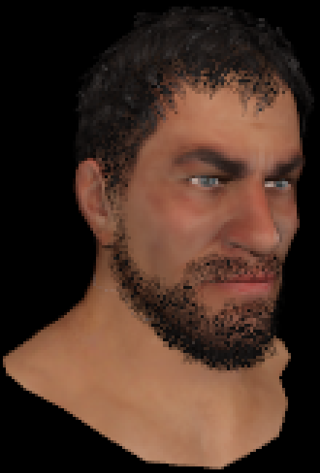
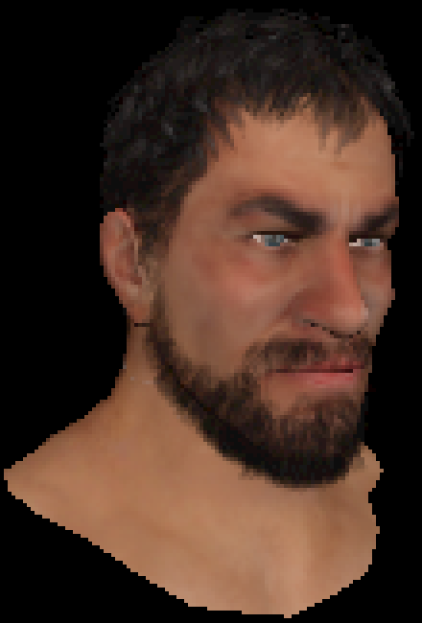
Helps WITH MSAA And A2C
8x alpha-to-coverage
8x hashed alpha-to-
coverage
Ground truth OIT

Slide 52
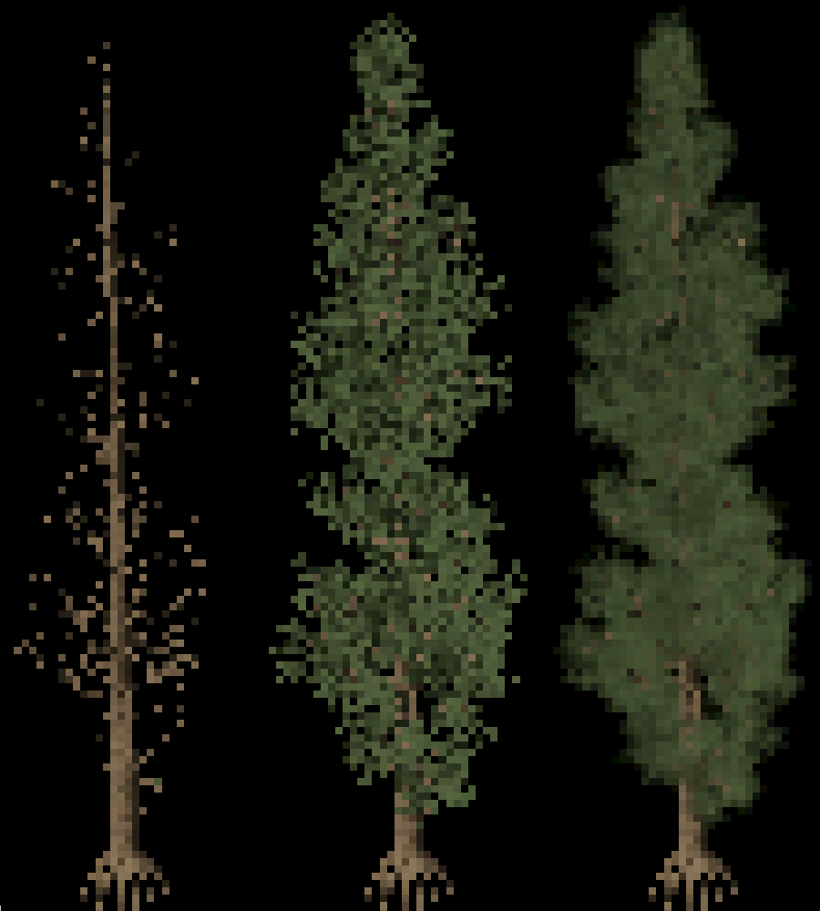
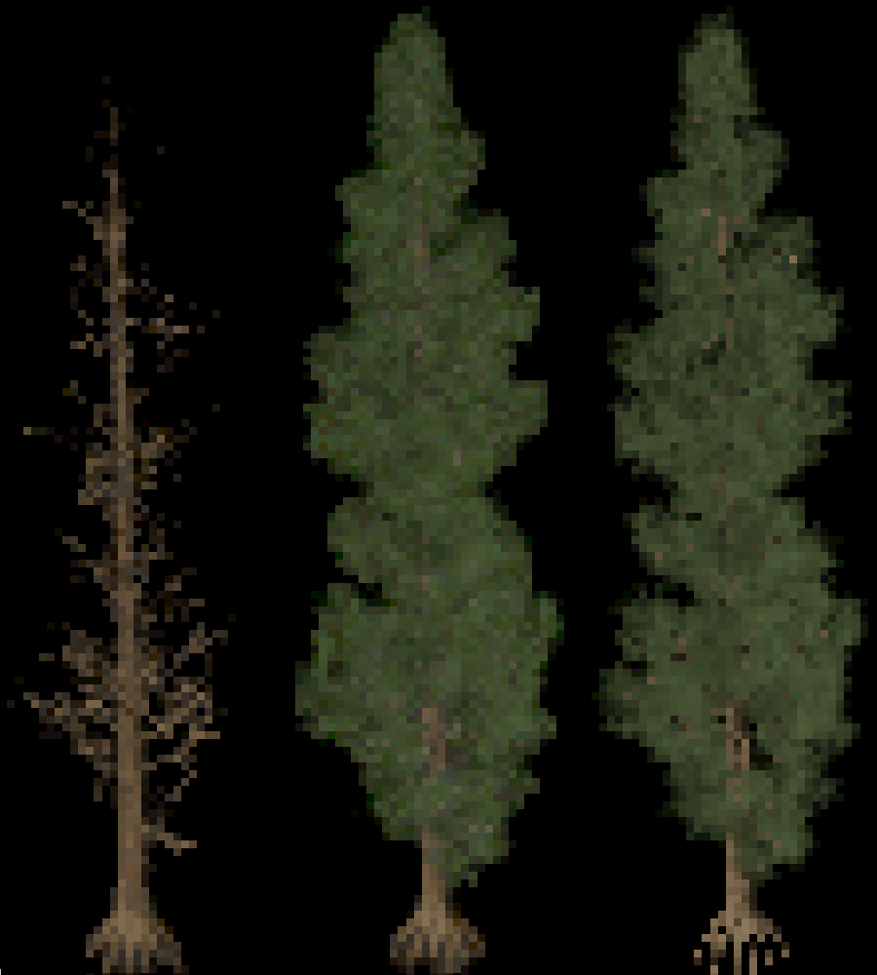
Temporal Antialiasing
No Temporal Antialiasing
With Temporal Antialiasing
Alpha Hashed Alpha Ground Truth
Alpha Hashed Alpha Ground Truth

Slide 53
Temporal Antialiasing
Might think, “based on stochastic sampling; of course TAA works well!”
But hashed alpha designed for stability under tiny camera motions, e.g. TAA jitter

Slide 54
Temporal Antialiasing
Might think, “based on stochastic sampling; of course TAA works well!”
But hashed alpha designed for stability under tiny camera motions, e.g. TAA jitter
A couple approaches:
Reduce global noise scale to < 1 pixel
TAA integrates sub pixel noise samples
Jitter offset in hash space;
Hash on objPos+offset[i] rather than objPos for relatively large, uncorrelated offset[i]
Jitter the alpha threshold
Compute α_{T} = hash( objPos ), use thresholds fract( α_{T} + i/N ) for i in [0…N)

Slide 55
Summary
Introduce new approach for alpha testing:
Alpha threshold cheaply & procedurally selected via a hash function
Gives stable noise; roughly as stable as traditional alpha test

Slide 56
Summary
Introduce new approach for alpha testing:
Alpha threshold cheaply & procedurally selected via a hash function
Gives stable noise; roughly as stable as traditional alpha test
Still use one alpha test per pixel, allowing:
Use in both deferred and forward pipelines
Run on older hardware; no new (or recent) features required

Slide 57
Summary
Introduce new approach for alpha testing:
Alpha threshold cheaply & procedurally selected via a hash function
Gives stable noise; roughly as stable as traditional alpha test
Still use one alpha test per pixel, allowing:
Use in both deferred and forward pipelines
Run on older hardware; no new (or recent) features required
Requires nothing in asset pipeline
Directly uses mip-chain’s alpha channels representing pre-filtered visibility

Slide 58
Summary
Introduce new approach for alpha testing:
Alpha threshold cheaply & procedurally selected via a hash function
Gives stable noise; roughly as stable as traditional alpha test
Still use one alpha test per pixel, allowing:
Use in both deferred and forward pipelines
Run on older hardware; no new (or recent) features required
Requires nothing in asset pipeline
Directly uses mip-chain’s alpha channels representing pre-filtered visibility
Can apply in other domains where stable shading locations important

Slide 59
Questions?
Alpha Test
Hashed Alpha
Ground Truth
cwyman@nvidia.com
@_cwyman_

